Slide 1
Soft Q-learning with Mutual Information Regularization Accepted in ICLR 2019
Kyeong Ryeol, Go
M.S. Candidate of OSI Lab

Slide 2
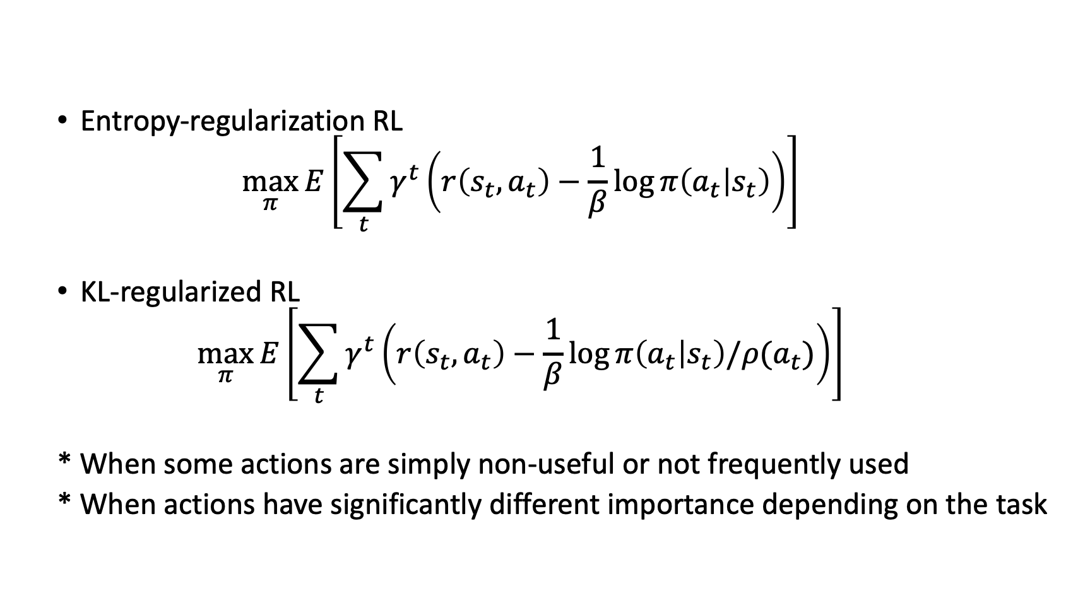
Motivation
Entropy-regularization RL
$$\max_{π}{E\left[\sum_{t}{γ^{t}\left(r\left(s_{t},a_{t}\right)−\frac{1}{β}\log{π\left(a_{t} | s_{t}\right)}\right)}\right]}$$
KL-regularized RL
$$\max_{π}{E\left[\sum_{t}{γ^{t}\left(r\left(s_{t},a_{t}\right)−\frac{1}{β}\log{π\left(a_{t} | s_{t}\right)/ρ(a_{t})}\right)}\right]}$$
* When some actions are simply non-useful or not frequently used
* When actions have significantly different importance depending on the task

Slide 3
Paper list
When some actions are simply non-useful or not frequently used
Soft q-learning with mutual information regularization (ICLR 2019)
When actions have significantly different importance
Information asymmetry in KL-regularized RL (ICLR 2019)
Exploiting hierarchy for learning and transfer in KL-regularized RL (Arxiv)

Slide 4
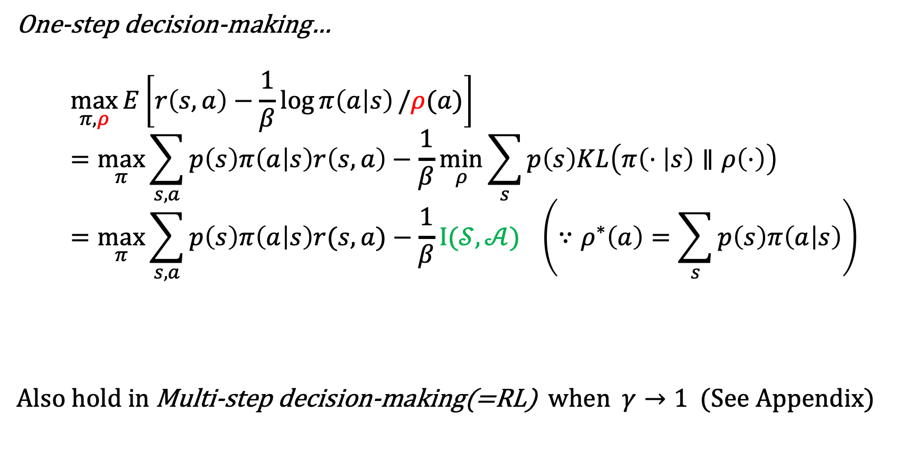
One-step decision-making…
$$\max_{π,ρ}{E\left[r\left(s,a\right)−\frac{1}{β}\log{π\left(a | s\right)}/ρ(a)\right]} \\ =\max_{π}{\sum_{s,a}{p\left(s\right)π\left(a | s\right)r\left(s,a\right)−\frac{1}{β}\min_{ρ}{\sum_{s}{p\left(s\right)KL\left(π\left(⋅ | s\right)∥ρ\left(⋅\right)\right)}}}} \\ =\max_{π}{\sum_{s,a}{p\left(s\right)π\left(a | s\right)r(s,a)}−\frac{1}{β}I(𝒮, 𝒜)} \left(∵ρ^{∗}\left(a\right)=\sum_{s}{p\left(s\right)π\left(a | s\right)}\right)$$
Also hold in Multi-step decision-making(=RL) when $γ→1$ (See Appendix)
mutual-information regularization

Slide 5
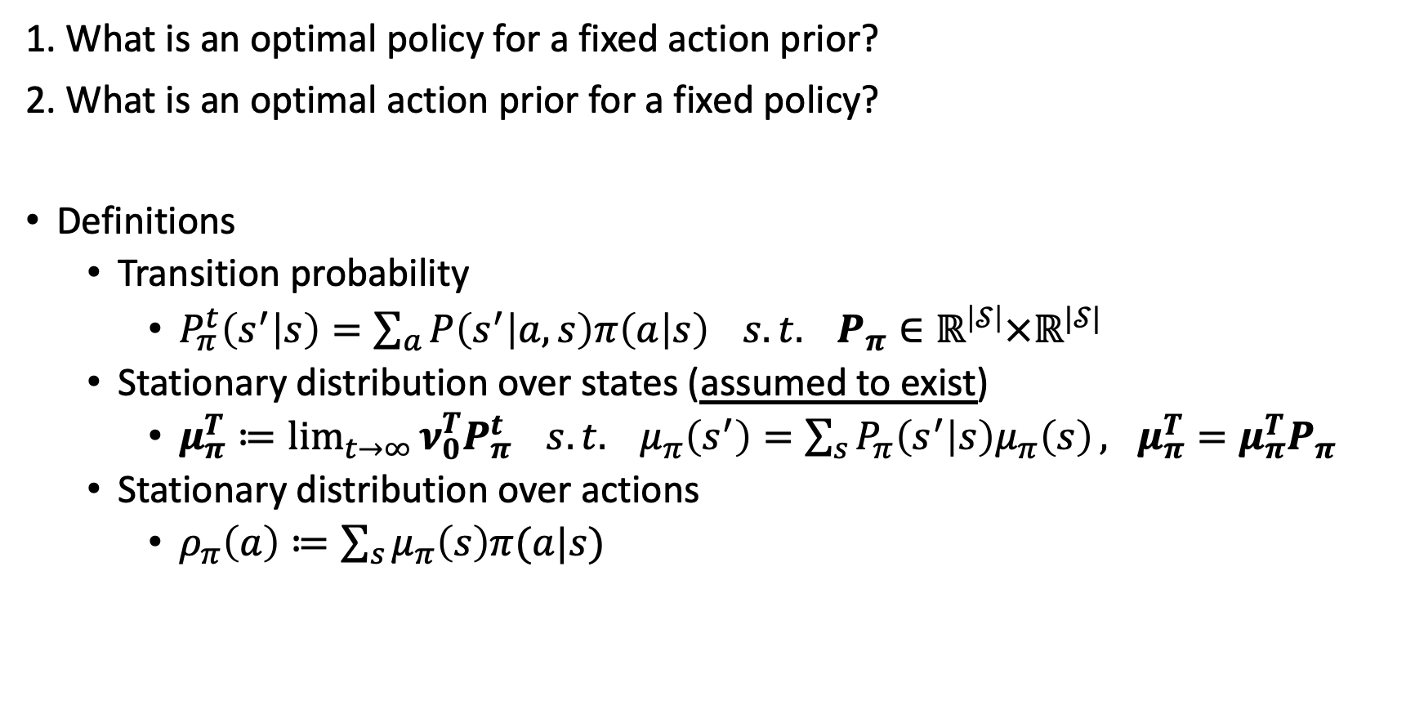
1. What is an optimal policy for a fixed action prior?
2. What is an optimal action prior for a fixed policy?
Definitions
Transition probability
$P_{π}^{t}\left(s^{′} | s\right)=\sum_{a}{P\left(s^{′} | a,s\right)π\left(a | s\right)} s.t. P_{π}∈ℝ^{\left|𝒮\right|}×ℝ^{|𝒮|}$
Stationary distribution over states (assumed to exist)
$μ_{π}^{T}≔\lim_{t→∞}{ν_{0}^{T}P_{π}^{t}} s.t. μ_{π}\left(s^{′}\right)=\sum_{s}{P_{π}\left(s^{′} | s\right)μ_{π}\left(s\right)}, μ_{π}^{T}=μ_{π}^{T}P_{π}$
Stationary distribution over actions
$ρ_{π}\left(a\right)≔\sum_{s}{μ_{π}\left(s\right)π(a|s)}$

Slide 6
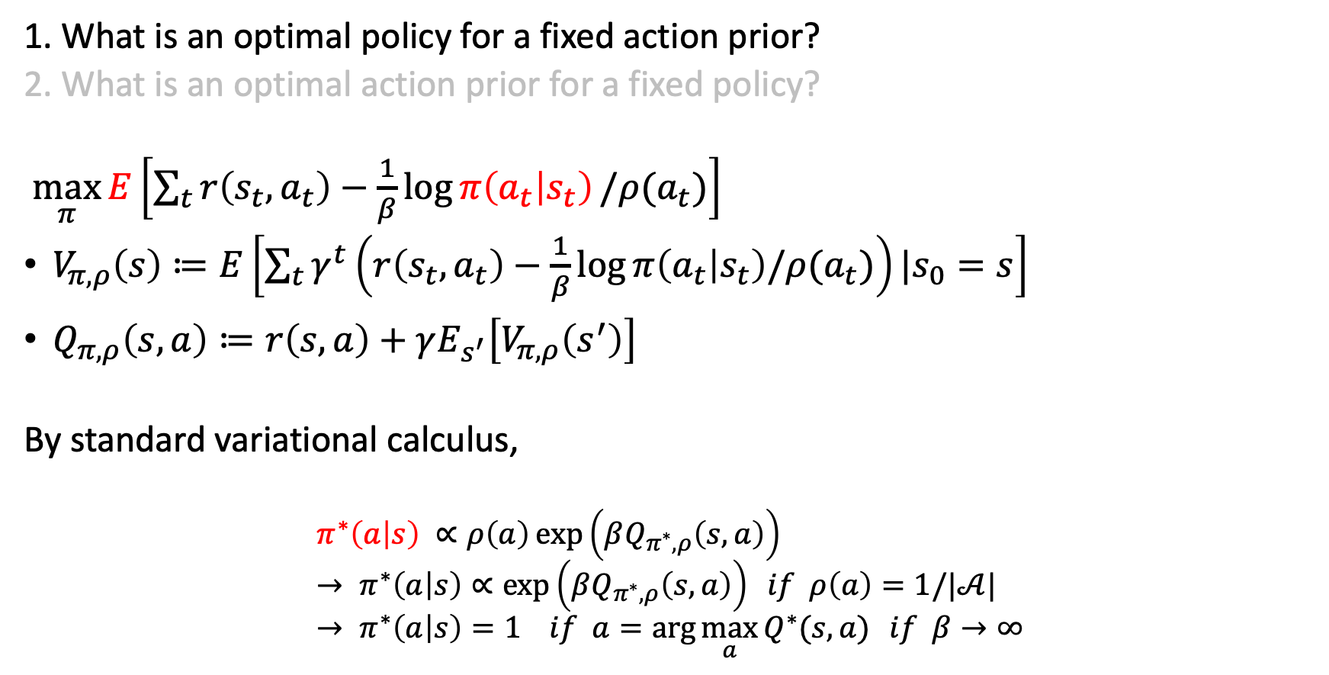
1. What is an optimal policy for a fixed action prior?
2. What is an optimal action prior for a fixed policy?
$\max_{π}{E\left[\sum_{t}{r\left(s_{t},a_{t}\right)−\frac{1}{β}\log{π\left(a_{t} | s_{t}\right)}/ρ(a_{t})}\right]}$
$V_{π,ρ}\left(s\right)≔E\left[\sum_{t}{γ^{t}\left(r\left(s_{t},a_{t}\right)−\frac{1}{β}\log{π\left(a_{t} | s_{t}\right)/ρ(a_{t})}\right)}|s_{0}=s\right]$
$Q_{π,ρ}\left(s,a\right)≔r\left(s,a\right)+γE_{s^{′}}\left[V_{π,ρ}\left(s^{′}\right)\right]$
By standard variational calculus,
$$π^{∗}\left(a | s\right) ∝ρ\left(a\right)\exp\left(βQ_{π^{∗},ρ}\left(s,a\right)\right) \\ → π^{∗}\left(a | s\right)∝\exp\left(βQ_{π^{∗},ρ}\left(s,a\right)\right) if ρ\left(a\right)=1/|𝒜| \\ → π^{∗}\left(a | s\right)=1 if a=\arg{\max_{a}{Q^{∗}(s,a)}} if β→∞$$

Slide 7

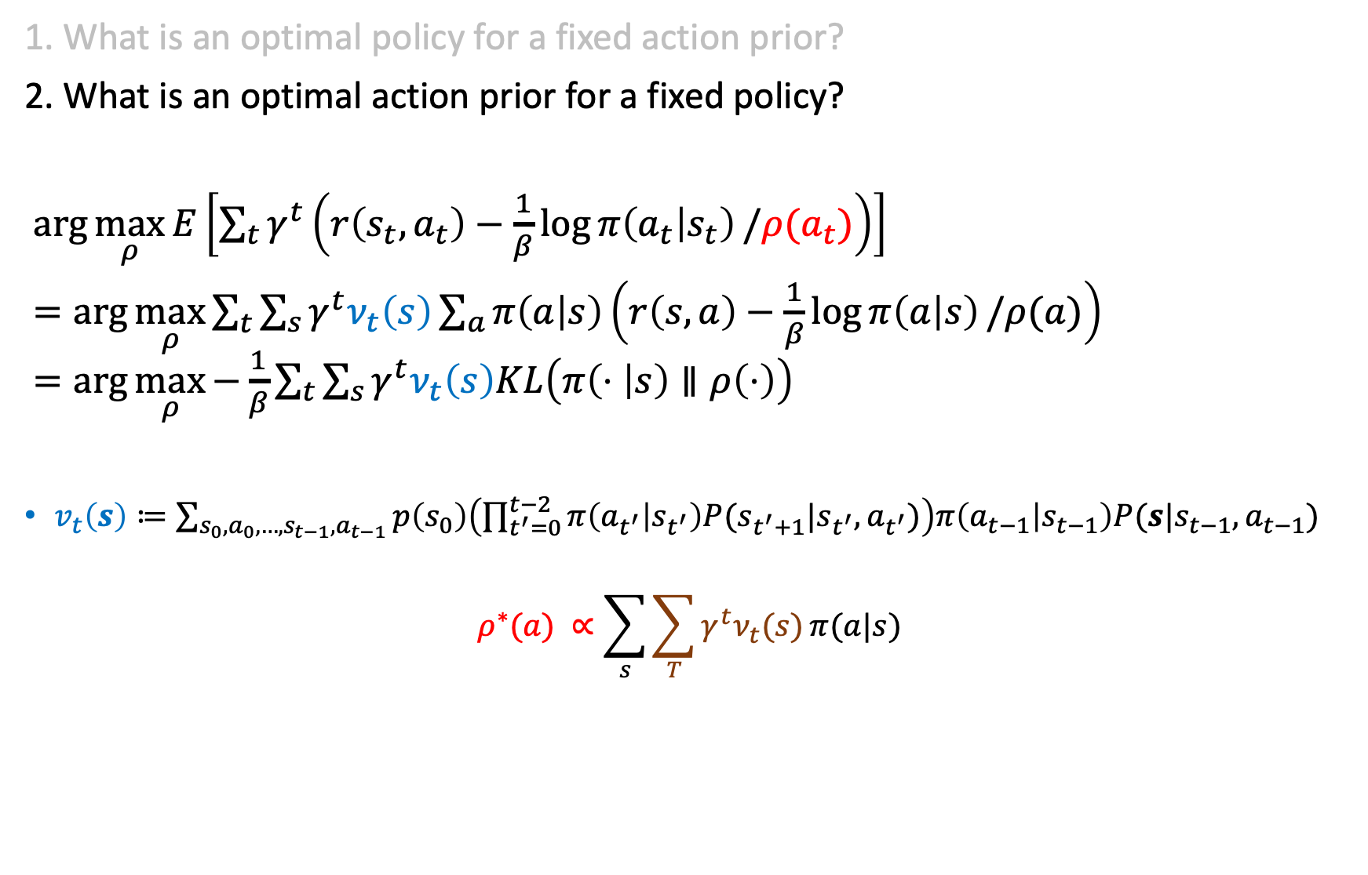
1. What is an optimal policy for a fixed action prior?
2. What is an optimal action prior for a fixed policy?
$\arg{\max_{ρ}{E\left[\sum_{t}{γ^{t}\left(r\left(s_{t},a_{t}\right)−\frac{1}{β}\log{π\left(a_{t} | s_{t}\right)}/ρ(a_{t})\right)}\right]}}$
$=\arg{\max_{ρ}{\sum_{t}{\sum_{s}{γ^{t}ν_{t}\left(s\right)\sum_{a}{π\left(a | s\right)}\left(r\left(s,a\right)−\frac{1}{β}\log{π\left(a | s\right)}/ρ(a)\right) }}}}$ $=\arg{\max_{ρ}{−\frac{1}{β}}\sum_{t}{\sum_{s}{γ^{t}ν_{t}\left(s\right)KL\left(π\left(⋅ | s\right)∥ρ\left(⋅\right)\right)}}}$
$v_{t}\left(s\right)≔\sum_{s_{0},a_{0},…,s_{t−1},a_{t−1}}{p\left(s_{0}\right)\left(\prod_{t^{′}=0}^{t−2}{π\left(a_{t^{′}} | s_{t^{′}}\right)P(s_{t^{′}+1}|s_{t^{′}},a_{t^{′}})}\right)π\left(a_{t−1} | s_{t−1}\right)P(s|s_{t−1},a_{t−1})}$
$$ρ^{∗}(a) ∝\sum_{s}{\sum_{T}{γ^{t}ν_{t}(s)}π(a|s)}$$
stationary distribution over actions
$μ_{π}\left(s\right)$ : stationary distribution over states

Slide 8
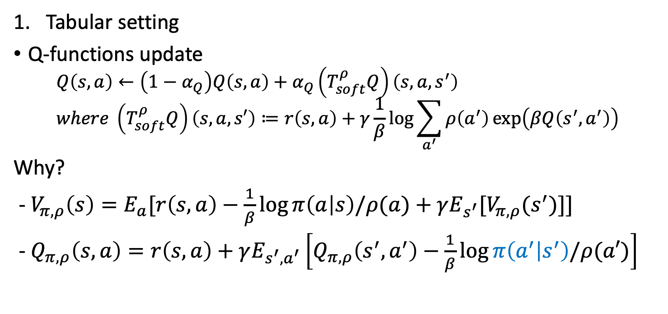
MIRL : Mutual Information RL
Tabular setting
Q-functions update
$$Q\left(s,a\right)←\left(1−α_{Q}\right)Q\left(s,a\right)+α_{Q}\left(T_{soft}^{ρ}Q\right)\left(s,a,s^{′}\right) \\ where \left(T_{soft}^{ρ}Q\right)\left(s,a,s′\right)≔r\left(s,a\right)+γ\frac{1}{β}\log{\sum_{a^{′}}{ρ\left(a^{′}\right)\exp\left(βQ\left(s^{′},a^{′}\right)\right)}}$$
Why?
- $V_{π,ρ}\left(s\right)=E_{a}[r\left(s,a\right)−\frac{1}{β}\log{π\left(a | s\right)/ρ(a)}+γE_{s^{′}}[V_{π,ρ}(s^{′})]]$
- $Q_{π,ρ}\left(s,a\right)=r\left(s,a\right)+γE_{s^{′},a^{′}}\left[Q_{π,ρ}\left(s^{′},a^{′}\right)−\frac{1}{β}\log{π\left(a^{′} | s^{′}\right)/ρ(a′)}\right]$
Substitute $π\left(a | s\right)$ to $π^{upd}\left(a | s\right)∝ρ\left(a\right)\exp\left(βQ_{π,ρ}\left(s,a\right)\right)$

Slide 9
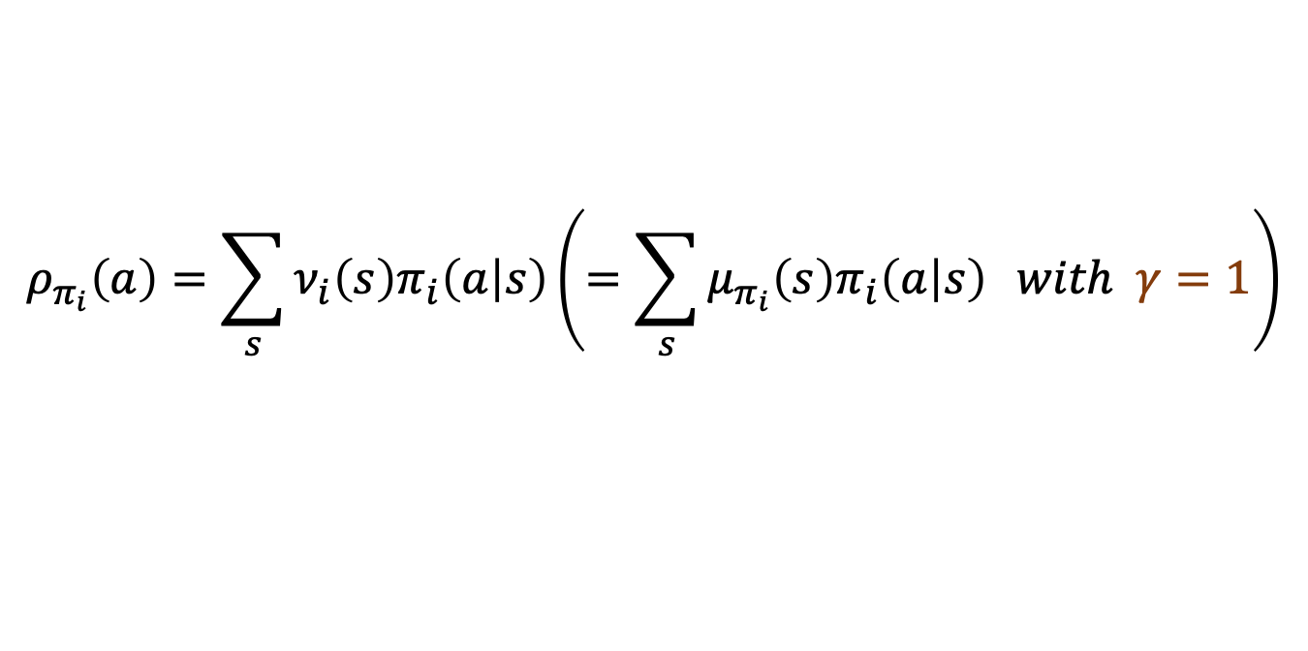

MIRL : Mutual Information RL
Tabular setting
Prior update
$$ρ_{i+1}\left(a\right)=\left(1−α_{ρ}\right)ρ_{i}\left(a\right)+α_{ρ}π_{i}\left(a | s_{i}\right) \\ where s_{i}\sim ν_{i}\left(s\right) and π_{i}\left(a | s_{i}\right)∝ρ_{i}\left(a\right)\exp\left(βQ_{i}\left(s_{i},a\right)\right)$$
$β$ update
$$β_{i}=c⋅i$$
Converge to…
$$ρ_{π_{i}}\left(a\right)=\sum_{s}{ν_{i}\left(s\right)π_{i}\left(a | s\right)}\left(=\sum_{s}{μ_{π_{i}}\left(s\right)π_{i}\left(a | s\right)} with γ=1\right)$$
Common practice in actor-critic

Slide 10
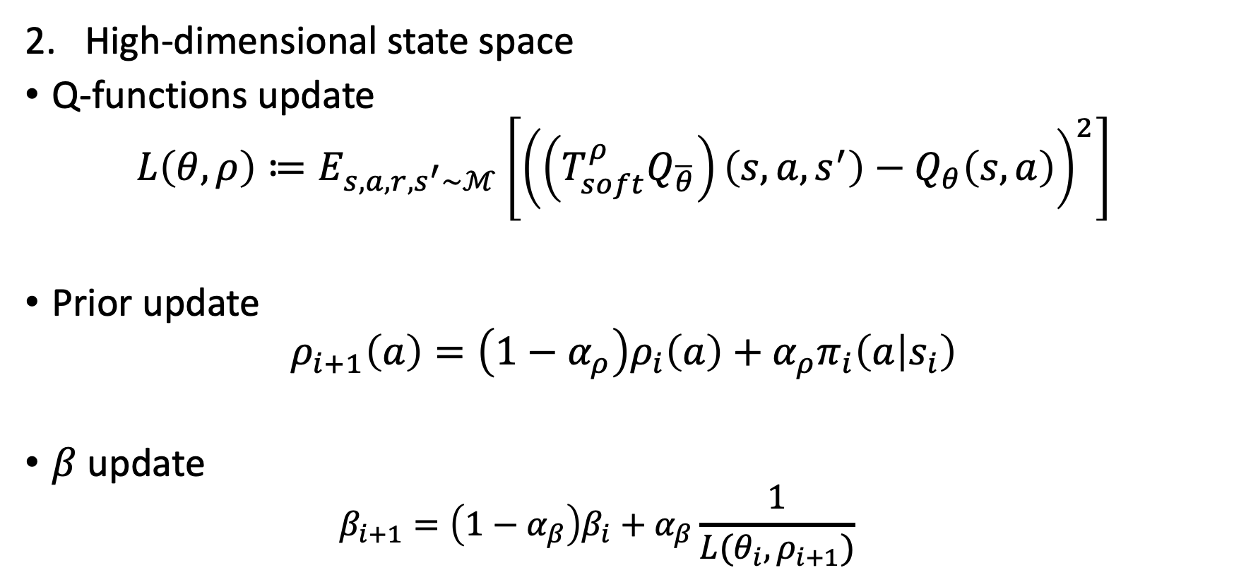
MIRL : Mutual Information RL
High-dimensional state space
Q-functions update
$$L\left(θ,ρ\right)≔E_{s,a,r,s^{′}\sim ℳ}\left[{\left(\left(T_{soft}^{ρ}Q_{\overline{θ}}\right)\left(s,a,s^{′}\right)−Q_{θ}\left(s,a\right)\right)}^{2}\right]$$
Prior update
$$ρ_{i+1}\left(a\right)=\left(1−α_{ρ}\right)ρ_{i}\left(a\right)+α_{ρ}π_{i}\left(a | s_{i}\right)$$
$β$ update
$$β_{i+1}=\left(1−α_{β}\right)β_{i}+α_{β}\frac{1}{L(θ_{i},ρ_{i+1})}$$

Slide 11
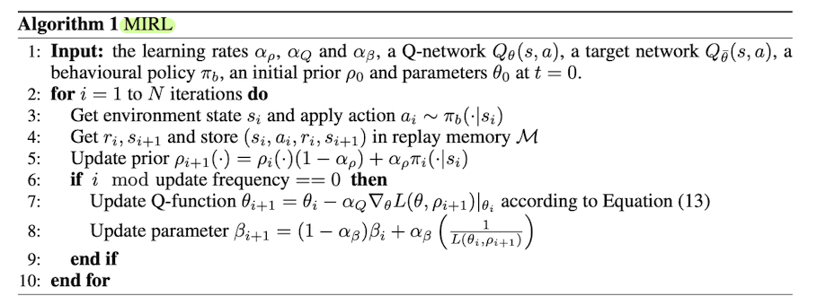
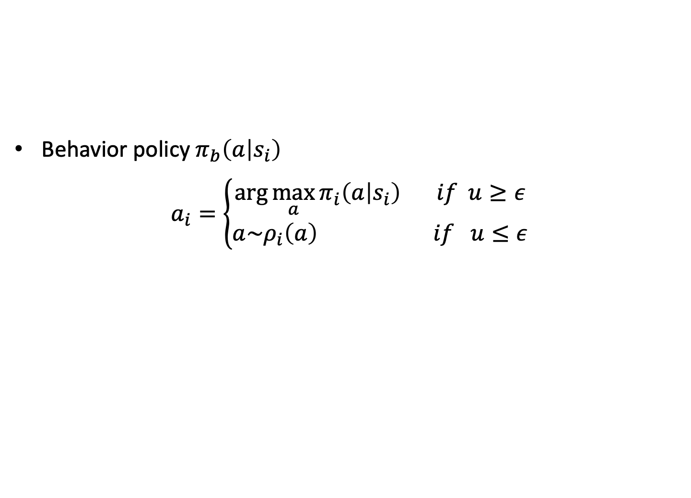
Behavior policy $π_{b}\left(a | s_{i}\right)$
$$a_{i}=\left\{\begin{aligned}\arg{\max_{a}{π_{i}\left(a | s_{i}\right)}} if u≥ε \\ a\sim ρ_{i}\left(a\right) if u≤ε\end{aligned}\right.$$
Exploitation
Exploration

Slide 12


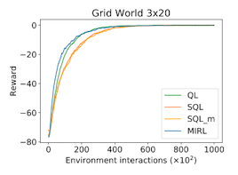
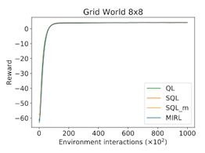
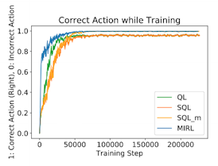
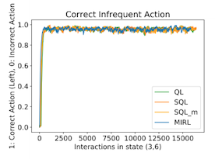
Grid-world
Square world
Corridor
Settings
Reaching a goal : reward 9
Else : reward -1
Restarted in a random location
Baseline
> Q-learning (QL)
> Soft Q-learning (SQL)
> Soft Q-learning + behavior policy (SQL_m)
> MIRL

Slide 13
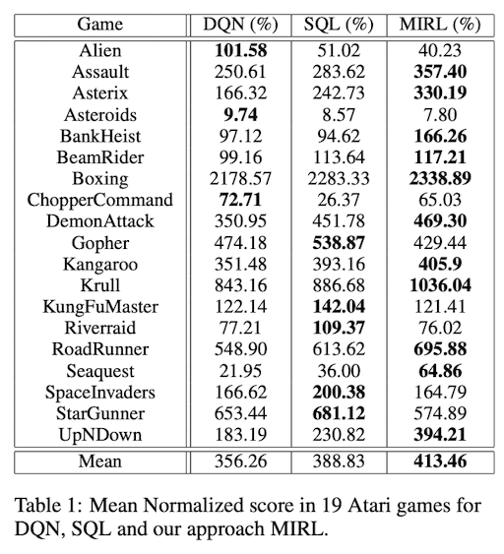
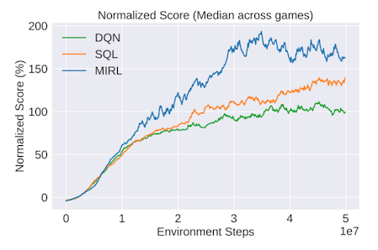
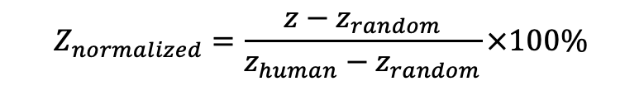
ATARI
$$Z_{normalized}=\frac{z−z_{random}}{z_{human}−z_{random}}×100\%$$
Baselines
> Deep Q-Network (DQN)
> Soft Q-learning (SQL)
> MIRL

Slide 14
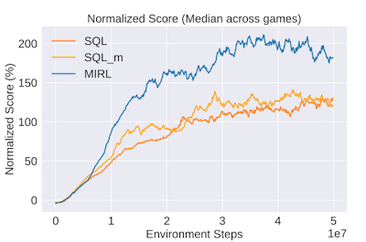
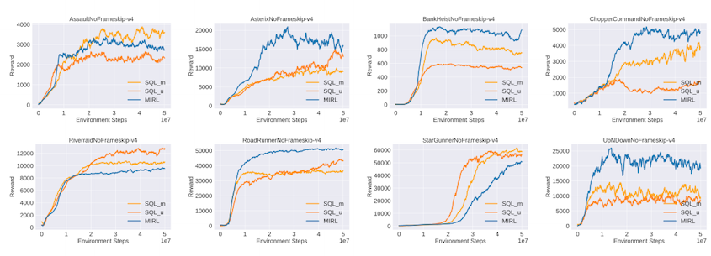
Ablation study
Baselines
> Soft Q-learning (SQL)
> Soft Q-learning + behavior policy (SQL_m)
> MIRL

Slide 15
Information asymmetry in KL-regularized RL (ICLR 2019)

Slide 16
Exploiting hierarchy for learning and transfer in KL-regularized RL (Arxiv)

